Slide 1


“Let Me Unwind That For You: Exceptions to Backward Edge Protection”
Submitted to Dr. Shaoquan Jiang
Notes:
Slide 1: Research Paper Title - "Let Me Unwind That For You: Exceptions to Backward Edge Protection"
Good [morning/afternoon/evening], everyone. Today, I'm excited to present a research paper titled "Let Me Unwind That For You: Exceptions to Backward Edge Protection.” Let's dive into the key aspects of this intriguing study.

Slide 2
TOC
Introduction Paper Overview Problem
Existing Protections New Paradigms Conclusion
Notes:
Slide 2: Table of Contents (TOC)
Before we delve into the paper, let's take a quick look at the table of contents. We'll start with an introduction, followed by an overview of the paper, an exploration of the identified problem, a discussion on existing protections, insights into new paradigms, and finally, conclude with the implications drawn from the research.
----
Slide 2: Table of Contents (TOC)
Before we jump into the paper, let's quickly glance at the table of contents. We'll commence with an introduction, proceed to an overview of the paper, delve into the identified problem, examine existing protections, discuss emerging paradigms, and wrap up with conclusions drawn from the research.

Slide 3
Paper Overview
The paper investigates backward-edge control-ﬂow hijacking in software exploitation, challenging the assumption that attackers need to directly manipulate return addresses.
It introduces Catch Handler Oriented Programming (CHOP), exploiting stack corruption to divert execution to controlled catch handlers, enabling powerful primitives like arbitrary code execution.
The study demonstrates CHOP's applicability across platforms, surveys open-source packages to identify exploitable exception handlers, and concludes with proposed mitigations.
This research uncovers novel attack opportunities, emphasizing the evolving landscape of control-ﬂow manipulation and the necessity for adaptive defense strategies.
Notes:
Slide 3: Paper Overview
Our paper investigates a fascinating aspect of software exploitation—backward-edge control-flow hijacking. Contrary to conventional wisdom, which assumes attackers manipulate return addresses directly, we introduce "Catch Handler Oriented Programming" (CHOP). CHOP exploits stack corruption to redirect execution to controlled catch handlers, enabling powerful primitives such as arbitrary code execution. The study showcases CHOP's applicability across platforms, surveys open-source packages for exploitable exception handlers, and proposes mitigations. This research uncovers novel attack opportunities, emphasizing the evolving landscape of control-flow manipulation and the necessity for adaptive defense strategies.
-----
Slide 3: Paper Overview
Our paper delves into a fascinating facet of software exploitation—backward-edge control-flow hijacking. Challenging the conventional belief that attackers directly manipulate return addresses, we introduce "Catch Handler Oriented Programming" (CHOP). CHOP exploits stack corruption to divert execution to controlled catch handlers, enabling potent primitives like arbitrary code execution. The study demonstrates CHOP's versatility across platforms, surveys open-source packages for exploitable exception handlers, and suggests mitigations. This research unveils novel attack opportunities, underscoring the ever-changing landscape of control-flow manipulation and the need for adaptive defense strategies.

Slide 4
Exceptional control ﬂow
Exceptional control ﬂow is a concept in computer science and programming that refers to the path a program takes in response to unexpected or exceptional events.
Unlike the normal control ﬂow, where a program executes sequentially or jumps to a speciﬁed section due to loops or conditions, exceptional control ﬂow is triggered by events such as errors, exceptions, or external interrupts.
For instance, consider a program that reads a ﬁle. If the ﬁle doesn't exist, instead of crashing, the program might take an exceptional control ﬂow to handle this error, perhaps by displaying an error message to the user.
Notes:
Slide 4: Exceptional Control Flow
To understand the context, let's clarify what exceptional control flow means.
In the realm of computer science and programming, exceptional control flow refers to the path a program takes in response to unexpected events. Unlike normal control flow, where execution follows a sequential or conditional path, exceptional control flow is triggered by errors, exceptions, or external interrupts. For instance, consider a program reading a file. If the file doesn't exist, instead of crashing, the program might take an exceptional control flow to manage this error, perhaps by displaying an error message to the user.

Slide 5
Importance
01
Robustness: It allows programs to handle unexpected situations gracefully without crashing. This is vital for software reliability.
02
User Experience: By providing meaningful error messages or alternative actions when something goes wrong, users are not left in the dark about what happened.
03
Security: Proper exception handling can prevent potential security vulnerabilities. For instance, without proper error handling, a program might reveal sensitive information in its error messages.
Notes:
Slide 5: Importance of Exceptional Control Flow
Now, why does exceptional control flow matter? Three critical aspects highlight its importance:
Robustness: Exceptional control flow allows programs to handle unexpected situations gracefully without crashing, enhancing software reliability.
User Experience: By providing meaningful error messages or alternative actions when something goes wrong, users are not left in the dark about what happened, improving overall user experience.
Security: Proper exception handling is crucial for security. Without it, a program might inadvertently reveal sensitive information in its error messages, posing potential security vulnerabilities.
In conclusion, "Let Me Unwind That For You: Exceptions to Backward Edge Protection” offers a deep dive into the nuanced world of backward-edge control-flow hijacking, challenging established assumptions and paving the way for adaptive defense strategies in the evolving landscape of software exploitation. Thank you for your attention. I'll be happy to take any questions you may have.
---
Slide 5: Importance of Exceptional Control Flow
Now, why does exceptional control flow matter? Three vital aspects underscore its significance:
Robustness: Exceptional control flow empowers programs to handle unforeseen situations gracefully without crashing, thereby enhancing software reliability.
User Experience: By offering meaningful error messages or alternative actions when something goes awry, users are kept informed about the issue, contributing to an enhanced user experience.
Security: Proper exception handling is pivotal for security. Without it, a program might inadvertently expose sensitive information in its error messages, potentially leading to security vulnerabilities.

Slide 6

Protection Method
1. Stack Canaries or Security Cookies:
What are they?
If it has, the program knows a buffer overﬂow has occurred and can take appropriate action, like terminating the process.
Why are they important? Shadow stacks provide a robust mechanism against
return-oriented programming (ROP) attacks, where attackers exploit existing code sequences in unintended ways.
How do they work?
Stack canaries are a security measure against buffer overflow attacks. They work by checking if an attacker has modified the canary value before a function concludes, preventing unauthorized changes to the program's flow.
Notes:
What are they?
Stack canaries are random values added to the stack before the return address to enhance security.
How do they work?
Stack canaries are a security measure against buffer overflow attacks. They work by checking if an attacker has modified the canary value before a function concludes, preventing unauthorized changes to the program's flow.

Slide 7

Protection Method
2. Shadow Stacks:
What are they?
A shadow stack is a separate, protected stack that stores return addresses.
If they differ, a security violation has occurred.
Why are they important? They provide a simple yet effective mechanism to detect stack-based buffer overﬂows, which are common attack vectors.
How do they work?
Every time a function is called, the return address is pushed onto both the regular stack and the shadow stack. When the function returns, the return address from the main stack is compared to the one on the shadow stack.

Slide 8
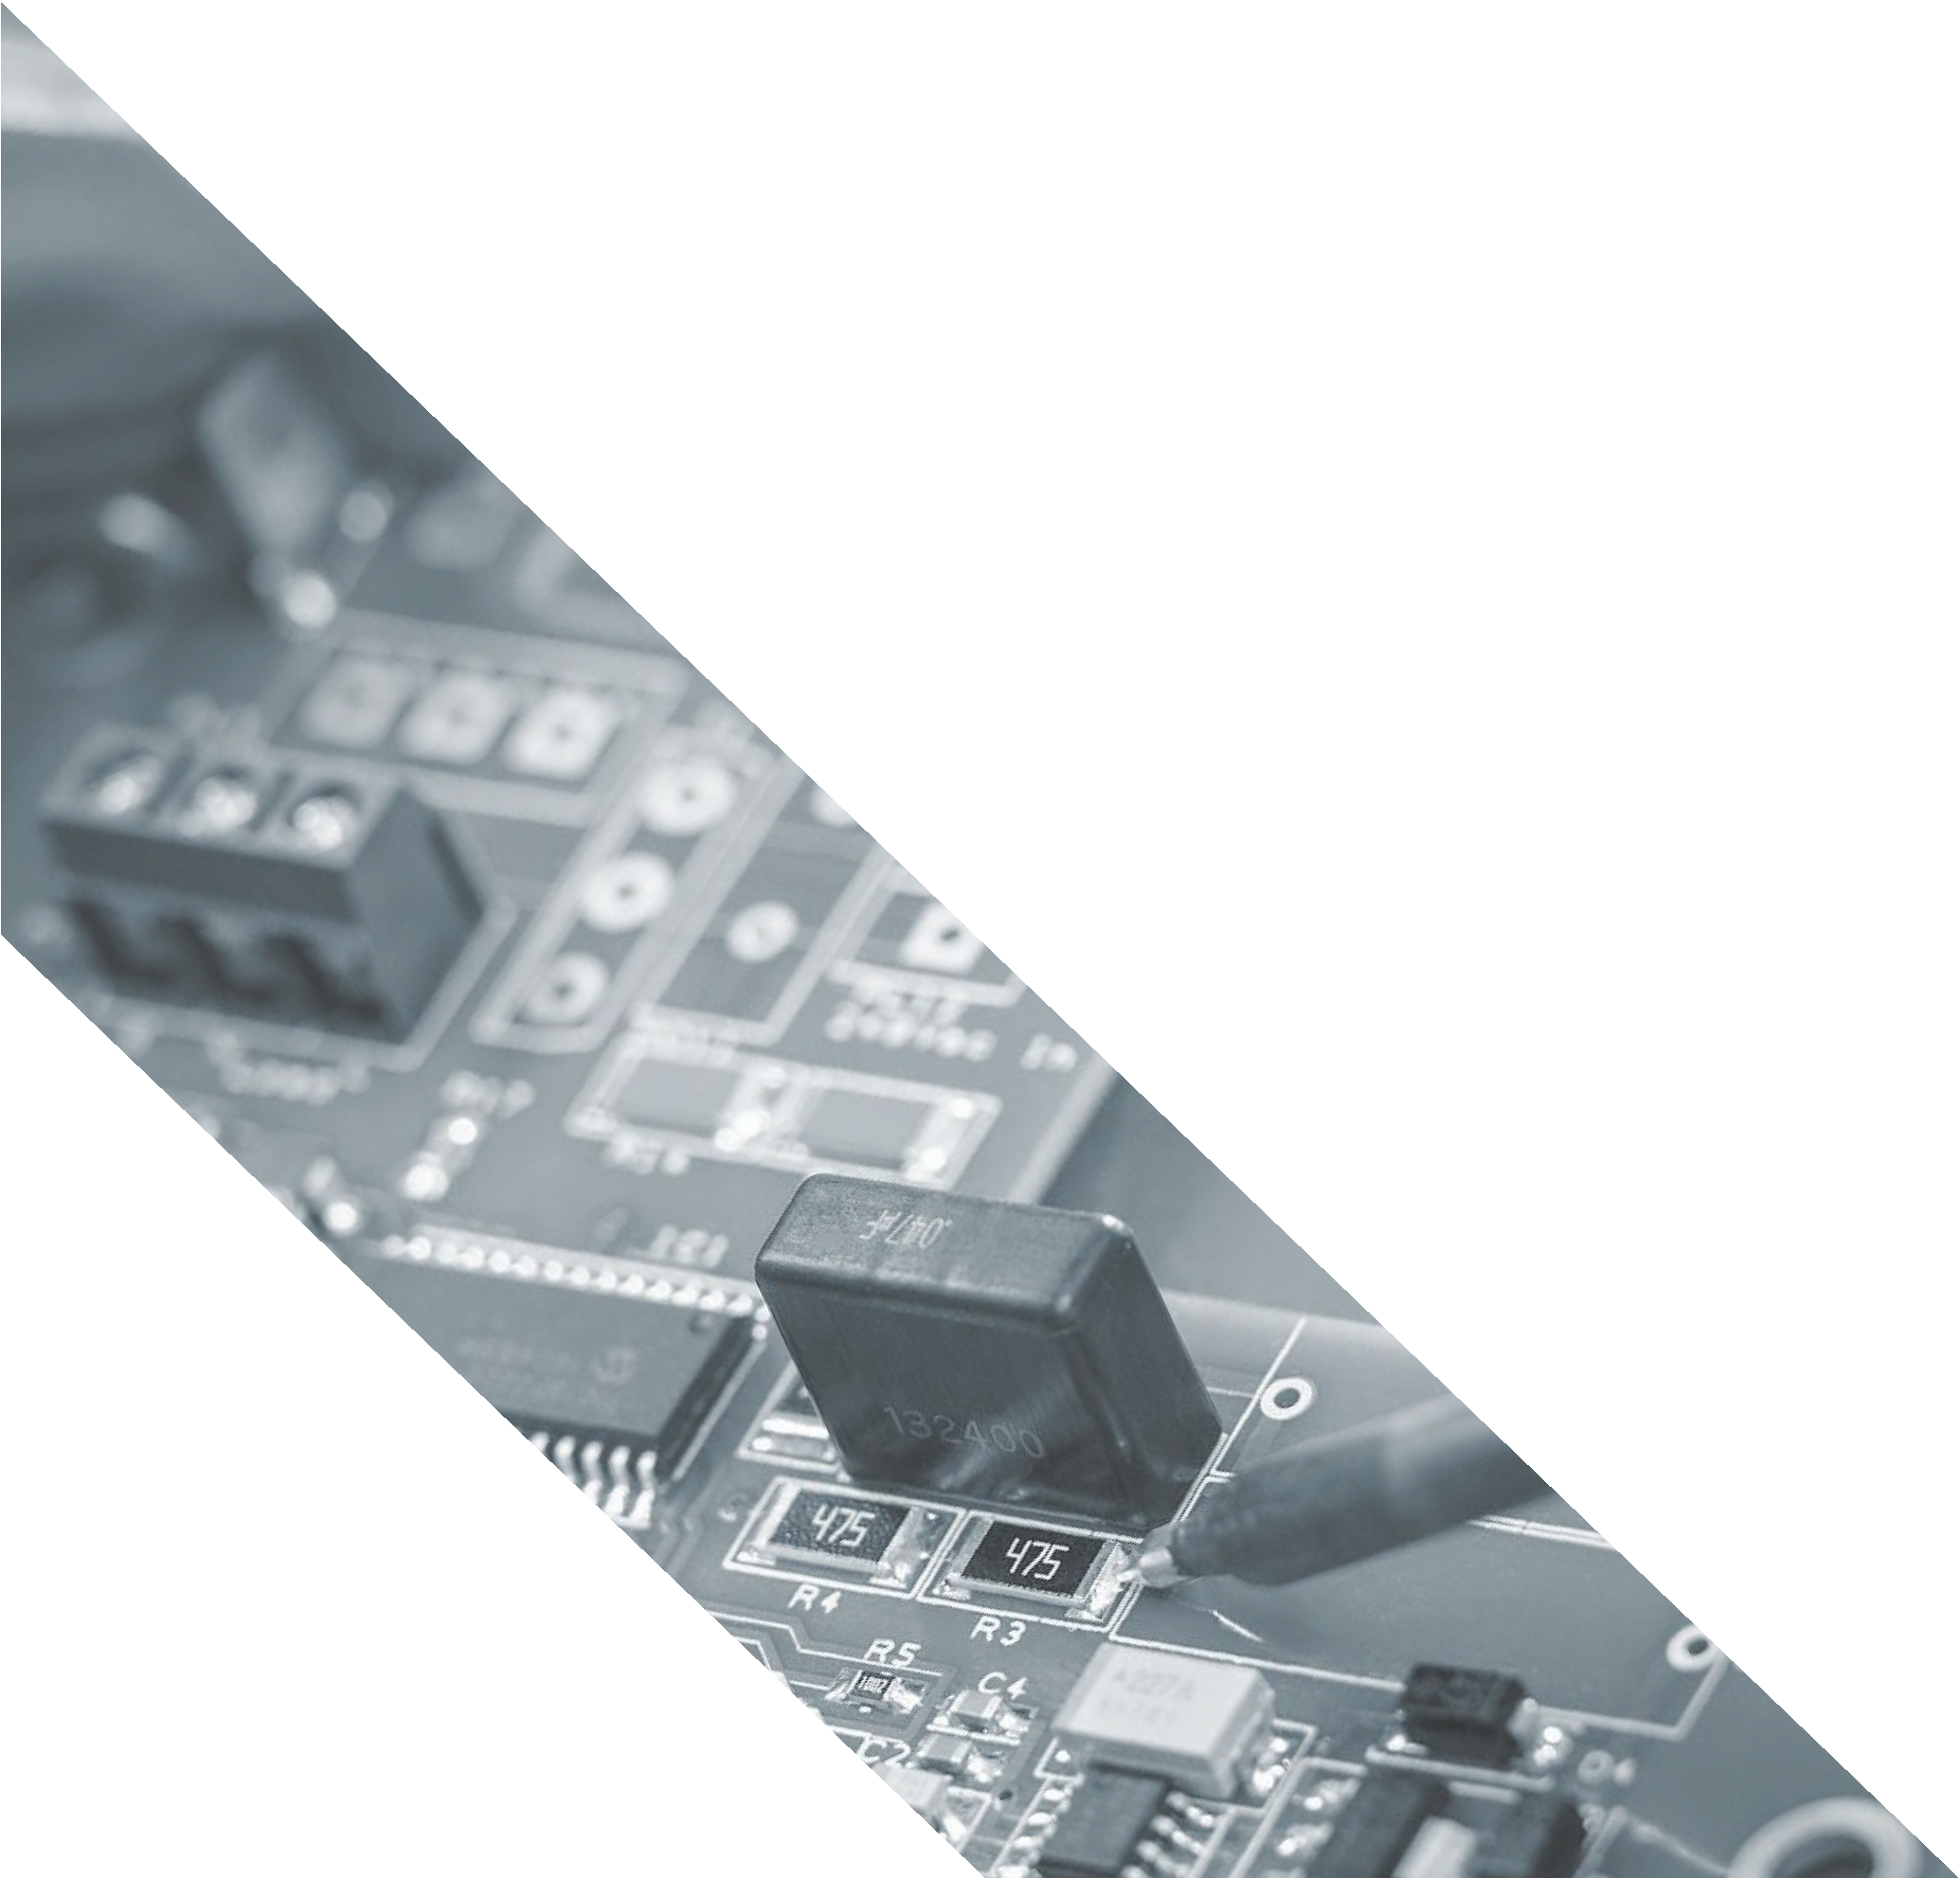
CHOP Attacks
What is CHOP Attacks?
Confused Handler-Oriented Programming (CHOP) is a novel attack paradigm that speciﬁcally targets the exception handling mechanisms in programming languages.
Exception handling is designed to manage unexpected or exceptional situations in code. However, CHOP exploits vulnerabilities within this system to achieve malicious objectives.

Slide 9
CHOP Attacks
Why is it signiﬁcant?
Exception handling is a fundamental component of many modern software applications. If attackers can exploit this system, they can potentially gain unauthorized access or control over a signiﬁcant portion of software infrastructure.

Slide 10
CHOP Attacks
Confusion Primitives
These are basic building blocks or tools that an attacker uses to induce confusion or misbehavior in a program's exception handling routines.
By leveraging confusion primitives, attackers can manipulate the normal ﬂow of exception handling, causing the program to execute unintended sequences of code or operations.
Gadgets
In the context of CHOP, gadgets refer to small pieces or sequences of code that can be exploited by an attacker to perform speciﬁc tasks or operations. These are not malicious by themselves but can be used maliciously when combined in a particular sequence.
Gadgets are the "tools" that attackers string together to craft a CHOP attack. By chaining together multiple gadgets, attackers can create a sequence of operations that lead to a full-ﬂedged exploit.
Gadgets
In the context of CHOP, gadgets refer to small pieces or sequences of code that can be exploited by an attacker to perform speciﬁc tasks or operations. These are not malicious by themselves but can be used maliciously when combined in a particular sequence.
Gadgets are the "tools" that attackers string together to craft a CHOP attack. By chaining together multiple gadgets, attackers can create a sequence of operations that lead to a full-ﬂedged exploit.

Slide 11
CHOP Attacks: Exploitation Strategies
The synthesis of confusion primitives and gadget capabilities in CHOP-style attacks enables diverse exploitation strategies. These strategies exploit vulnerabilities in exception handling mechanisms for arbitrary code execution and mitigation circumvention.
Golden Gadget: The "golden handler" technique within libstdc++ exempliﬁes direct exploitation. It diverts execution by manipulating the saved return address and controlling stack data, using an indirect call for potency.
Pivot-to-ROP: Attackers exploit functions with gadgets to perform traditional ROP attacks, bypassing backward-edge protections, even in the presence of stack canaries.
Data-Only Corruptions: Data-only attacks involve manipulating local stack frames, using cleanup or exception handlers to work on manipulated data. This approach can bypass ASLR without overwriting return addresses.
Cleanup-Handler Chaining: Attackers chain fake stack frames with cleanup handlers, creating sequences for multi-gadget use, similar to traditional ROP attacks.
SigReturn-to-ROP: By pivoting the unwinding process from the stack to an attacker-controlled buffer via SigReturn frame confusion, attackers execute ROP chains in controlled buffers. This tactic showcases versatile attack possibilities arising from CHOP-style techniques.

Slide 12
CHOP attack: Implementation and Evaluation
Researchers employed a two-step procedure for data collection and analysis.
Packages were downloaded from Debian Buster's main AMD64 repository.
Extracted metadata included ﬁle names, associated packages, ﬁle types, and directory locations.
Metadata stored in a PostgreSQL database for further analysis.
Challenge: Accurately identifying exception-handling packages.
Traditional dependency-based approach (using libstdc++) deemed inaccurate.
Precise approach adopted: Focused on binary programs and shared libraries.
Binary Ninja's capabilities used to identify programs with exception-handling characteristics.
Reﬁned method successfully overcame previous limitations in package identiﬁcation.

Slide 13
CHOP attack: Implementation and Evaluation
Researchers employed a comprehensive strategy to assess CHOP attack potential attack surface.
Stack canaries were used to identify memory-corruptible functions; analysis extended to callee functions.
CHOP gadgets' capabilities were deeply analyzed, identifying provided exploitation primitives.
Static taint tracking assessed impact of controlled registers, categorized into taint sink types.
Attacker model involved stack corruption, controlled backward edges, and callee-saved registers.
Taint analysis engine created using Binary Ninja's HLIL representation, categorizing sink types.
Feasibility scoring assigned to each gadget based on nested branches, loops, and function calls.
Potential gadget stack frame manipulation attack surface prudently ignored.
Study concludes by raising research questions about C++ software's exception handling and CHOP feasibility.

Slide 14
Mitigations
Advanced hardening strategies are proposed for scenarios where attackers can circumvent stack canaries.
Context-aware unwinding mechanism is suggested as a potential solution to enhance security.
Modifying the unwinder to operate on shadow stack data instead of the original stack data is recommended.
Authors acknowledge that these modiﬁcations could be extensive and might conﬂict with the Itanium C++ ABI.
The Itanium C++ ABI is a speciﬁcation for exception handling in C++ on Itanium and other platforms.
Propose minimizing the use of 'catch-all' and lenient catch handlers to limit attacker opportunities.
Recommend employing speciﬁc handlers for each exception and reducing the number of handlers in popular libraries.
Suggest randomization-based defenses like function reordering and stack layout randomization.

Slide 15










Thank you!

